Slide 1
Probability Type Inference for Flexible Approximate Programming
By: Brett Boston, Adrian Sampson, Dan Grossman, and Luis Ceze
Presented By: Steven Paek

Slide 2
About the Authors

Slide 3
About the Authors
Brett Boston - Currently a Graduate Student at MIT in the Computer Science and Artificial Intelligence Lab. He was an undergraduate student at the University of Washington with Adrian Sampson under Dan Grossman and Luis Ceze.
https://people.csail.mit.edu/boston/
Adrian Sampson - Currently an Assistant Professor at Cornell University. He graduated with a Ph.D from the University of Washington in 2015 under Luis Ceze and Dan Grossman. His research is primarily in computer architecture and programming languages. Specifically, we look at many of his programming language papers involving approximate computing.
http://www.cs.cornell.edu/~asampson/
Notes:
Scalability of the design improves since IP can be replaced easily

Slide 4
About the Authors
Dan Grossman - Professor and Vice Director of the Department of Computer Science and Engineering at the University of Washington. His research is primarily focused on programming languages, encompassing theory, implementation, and design.
https://homes.cs.washington.edu/~djg/
Luis Ceze - Professor of the Department of Computer Science and Engineering at the University of Washington. His research is primarily focused on computer architecture, programming languages, machine learning, and molecular biology.
https://www.cs.washington.edu/people/faculty/luisceze
Notes:
Scalability of the design improves since IP can be replaced easily

Slide 5
About the Authors
Considering the authors’ backgrounds in programming languages and implementation, it makes sense that much of their research in approximate computing would use programming languages and compilers as the “medium” to implement their ideas on approximate computing.
Notes:
Scalability of the design improves since IP can be replaced easily

Slide 6
Background Information

Slide 7
Background Information: Paper Links
EnerJ
https://homes.cs.washington.edu/~luisceze/publications/Enerj-pldi2011.pdf
Z3 SMT Solver
https://www.semanticscholar.org/paper/Z3%3A-An-Efficient-SMT-Solver-Moura-Bj%C3%B8rner/3960dda299e0f8615a7db675b8e6905b375ecf8a
Notes:
Scalability of the design improves since IP can be replaced easily

Slide 8
Background Information: EnerJ
Introduces concept of approximate data types to designate
Objective is to optimize energy savings
Implemented on top of Java and experimented on benchmarks across various applications
Notes:
Scalability of the design improves since IP can be replaced easily

Slide 9
Background Information: Z3 SMT Solver
For the purposes of this paper, SMT is related to constraint satisfaction, and thus constraint programming.
Z3 SMT Solver is a tool released from Microsoft Research that is used in software verification and software analysis, i.e. programming languages.
For more information about SMT:
https://en.wikipedia.org/wiki/Satisfiability_modulo_theories

Slide 10
Paper Analysis

Slide 11
What to look for in approximate computing papers?
What problem is being solved? Balancing manual and automatic assignment of approximation types and operations in programming languages to optimize energy savings
Why is that problem important? It is tedious/difficult to manual assign every operator in code for approximation, but may be unsafe to automatically assign operators with no user control.
How do the authors solve the problem? DECAF, Energy-aware Compiler to make Approximation Flexible.
How is the solution novel? Addresses multi-level probability architectures, augments static guarantees with run-time monitoring, speciales functions based on calling context, and adds flexible approximation annotations from user definitions.
What are other similar approaches? EnerJ, previously written by Adrian Sampson
How were the experiments done? Java benchmarks using hardware architecture simulations
What do the experiments show? Capable of producing energy savings based on approximation, and improved results if hardware architecture is specified.
Notes:
Packets, frames, flits, etc

Slide 12
What to look for in approximate computing papers?
What type of approximation? Constraints for probability of data correctness to achieve energy savings
Approximation strategy? Reduce probability of correct data to optimize energy savings
How is it done? DECAF, Energy-aware Compiler to make Approximation Flexible
What is being approximated? Data types and operations
How to determine what to approximate? User defined and inference
How much approximation is acceptable? User defined and inference
What applications are being targeted? Multi-level approximate architectures and benchmarks
Notes:
Packets, frames, flits, etc

Slide 13
What does the paper address?
The paper tries to expand the EnerJ framework to support data type and operation approximation based on probabilities of approximate hardware.
The paper tries to provide a balance between manual and fully autonomous assignments of type/operation reliability.
The paper tries to establish a compiler and testing framework to evaluate the approximation capabilities of DECAF programming language.
The paper tries to provide a platform to measure approximation based on multi-level approximate hardware for architecture oblivious and architecture specific analysis with regards to energy savings.
Notes:
Packets, frames, flits, etc

Slide 14
What does the paper NOT address?
The paper does NOT try to discuss how accurate the results are from the approximation technique. The percentages and values defined in this paper are for probability of correct values, not percent error/margin.
The paper does NOT try to define what is considered multi-level approximate hardware, or what criteria is used to evaluate multi-level approximate hardware.
The paper does NOT try to compare compiler efficiency or energy savings across multiple computer architectures.
Notes:
Packets, frames, flits, etc

Slide 15
Implementation

Slide 16
DECAF Description
DECAF, an Energy-aware Compiler to make Approximation Flexible
“DECAF’s solver-aided type inference offers an intermediate solution that lets programmers write constraints only where they are most relevant. Combined with code specialization and dynamic tracking, DECAF gives programmers flexible control over the efficiency–accuracy trade-offs offered by approximate hardware.”
Driven by user-defined constraints for reliability of correctness
Notes:
Packets, frames, flits, etc

Slide 17
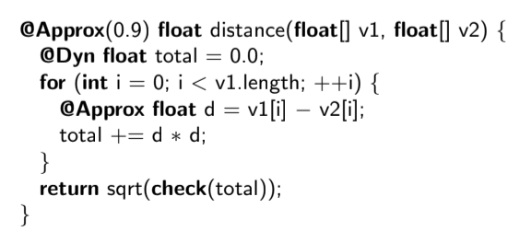
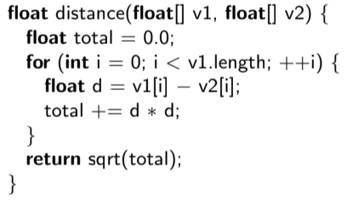
DECAF: Example Syntax
Notes:
Packets, frames, flits, etc

Slide 18
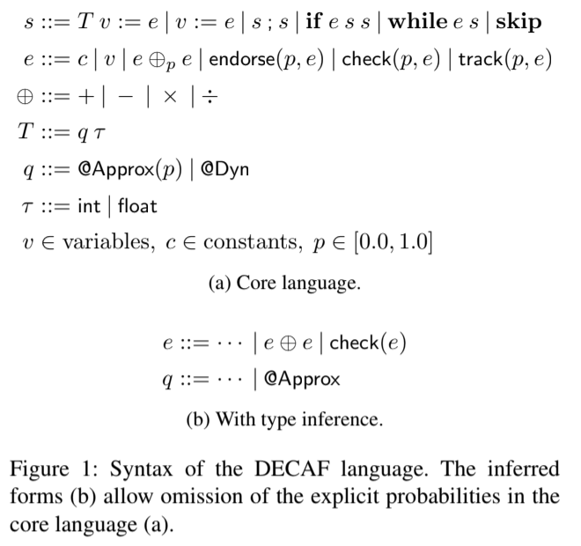
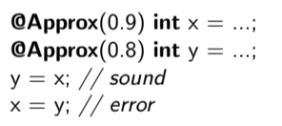
Probability Type System
Core Concept: Probability of Correctness
Based on EnerJ (Java) https://homes.cs.washington.edu/~luisceze/publications/Enerj-pldi2011.pdf
Assumptions - Inputs must be correct
Constraints types and operations for DECAF programming language i.e. only Approx(1.0) can be used for if and while
Rules for type are defined in Appendix A
Notes:
Assume 32 bits, MS

Slide 19
Inferring Probability Types
Inference allows for abstraction
It would be really annoying to define all the probabilities for every type and operation
Attempts to assign inferred probabilities to optimize energy savings by optimizing proxy
Continuous, uses SMT solver for analysis and verification
Combines traditional procedure cloning with SMT for best function specialization
Uses special compile-time parameters to handle unconstrained specialization and recursion to ensure live, bounded code
Notes:
Error in paper: I1, truncated data would be 0x00500000 therefore it should be code 100, not 011

Slide 20
Optional Dynamic Tracking
General dynamic mechanism for control flow at run-time
Inspired by gradual and optional typing https://www2.ccs.neu.edu/racket/pubs/dls06-tf.pdf
Convergent algorithms like simulated annealing
From experimentation, only loop-carried dependency required Dyn parameters

Slide 21
Using the Language
Constraint Warnings
Allows Approx(0.0) - Cannot guarantee accuracy
Forces Approx(1.0) - No optimization
Hardware profiles
A priori hardware profile
Probability maps used to track types across various probability constraints

Slide 22
Experimental Results

Slide 23
Results: Experimental Setup
Experimental Framework
Approximate processor architecture
No specific CPU design (Architecture Oblivious vs. Architecture Specific)
Simulated infrastructure with tunable instruction reliabilities
Z3 SMT is used to find operator reliabilities, minimize objective function, and determine satisfiability
EnerJ Extension and EnerJ Benchmark Suite (Java)
Optimize programs as static proxy for dynamic behavior by measuring dynamic executions
Hardware Setup
4-core, 2.9 GHz Intel Xeon, 2-way SMT, 8 GB RAM, Linux, OpenJDK 1.7.0 VM, Z3 Version 4.3.1
Raw Data: http://sampa.cs.washington.edu/decaf

Slide 24
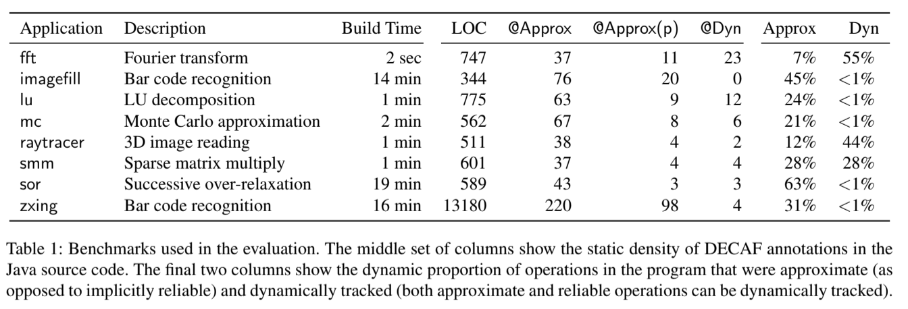
Results: Benchmarks and Build Times

Slide 25
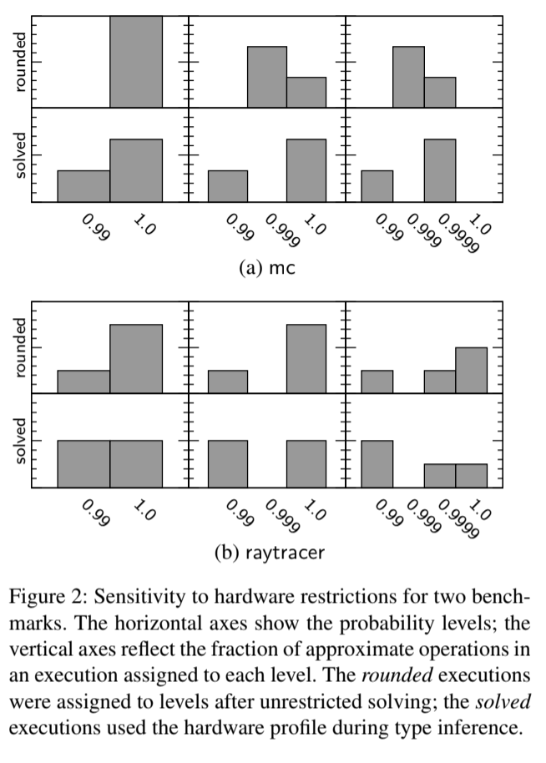
Results: Hardware Influence
Added levels of hardware approximation and probabilities of correctness improve assignment of approximate operations.
Specific hardware profiling improves approximate operation assignments as well.

Slide 26
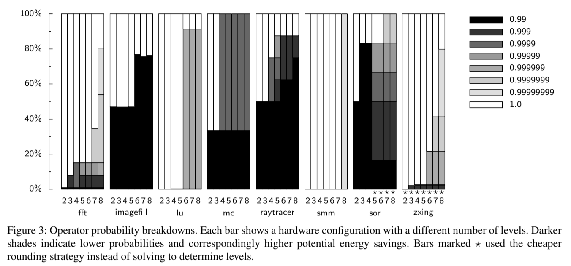
Results: Operator Probabilities for Benchmarks

Slide 27
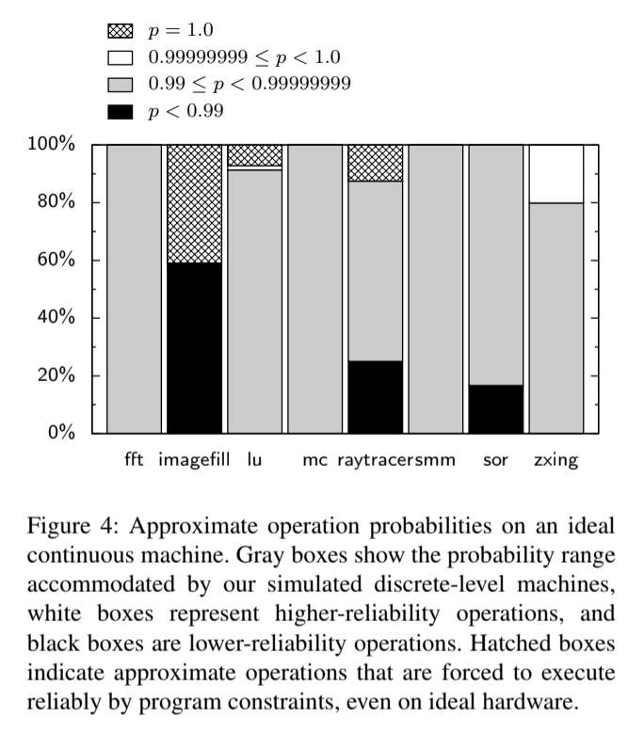
Results
Illustration of what approximate hardware probability ranges were most utilized in applications
Most results fall within the range of approximate operation probabilities fall within the range the describe as most optimal (0.99 ≤ p ≤ 0.99999999)
Imagefill also showed outlier performance in other tests

Slide 28
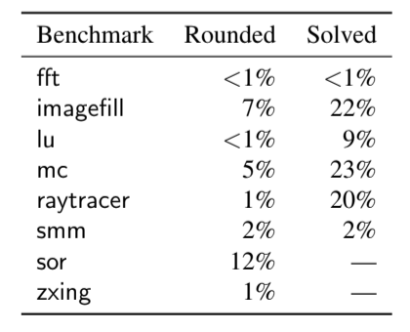
Results: Energy Savings for Benchmarks

Slide 29
Further Discussion

Slide 30
Further Discussion
Results require previous background knowledge to understand.
EnerJ
Z3 SMT Solver
No discussion about accuracy performance, solely reliability.
Does cost of compilation outweigh energy savings from approximation?
Probability of reliability is nice, but how does this affect result accuracy?
Description of multi-level hardware reliability is vague.
What does multi-level hardware reliability look like in a standard hardware setup?
What datasheet characteristics are used to measure this value?
Notes:
Scalability of the design improves since IP can be replaced easily

Slide 31
Questions

Slide 32
Question 1
DECAF extends which of the following frameworks and tools?
A) Neural Acceleration on NPU
B) EnerJ
C) Z3 SMT Solver
D) PANDORA

Slide 33
Question 2
What does DECAF apply approximation constraints to?
A) Data types and operations
B) Compilation times
C) Number of NPUs used for Computation
D) Place & Route for FPGA Implementation

Slide 34
Question 3
Which of the following statements is false?
A) DECAF infers the probabilities of data types and operations that are not specified by the user.
B) Adrian Sampson’s research primarily focuses on programming languages and computer architecture, which have applications to approximate computing.
C) DECAF supports using data types of lower accuracy probabilities into data types of higher accuracy probabilities without exception.
D) DECAF attempts to optimize energy savings by applying approximation constraints to the probabilities of accurate results from multi-level hardware.

